Slide 1

Heap Memory Management
FABRIKAM RESIDENCES

Slide 2
My Procedure
The all heap is a FREE one block in the first.
In runtime it converted to a doubly linked list.
Each node in the doubly linked list is a block of memory.
Each block can be FREE or NOT_FREE.
The allocated and not allocated blocks have the same metadata.
The used algorithm is the first-fit

Slide 3
Doubly linked list
The structure content
typedef struct free{
void* address;//address of this block
struct free *next;//address of the next block
struct free *privios;//addres of the prev block
int size;//size of the block
block_state free;//status of the block
}free_list;
typedef enum {
FREE,
NOT_FREE
}block_state;

Slide 4
Functions:
void initailiztion();
free_list* SplitBlock(free_list* block,int size );
void MerageTwoBlk(free_list* BlockOne,free_list* blockTwo);
void* My_malloc(int size);
void my_free(void* ptr);
void* my_calloc(size_t num,size_t size);
void* my_realloc(void* ptr, size_t newSize);

Slide 5
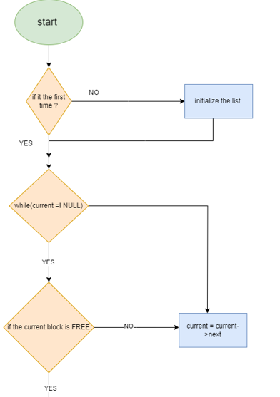
My_malloc flowchart

Slide 6
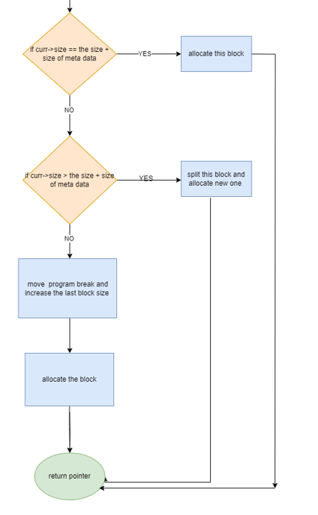
My_malloc flowchart

Slide 7
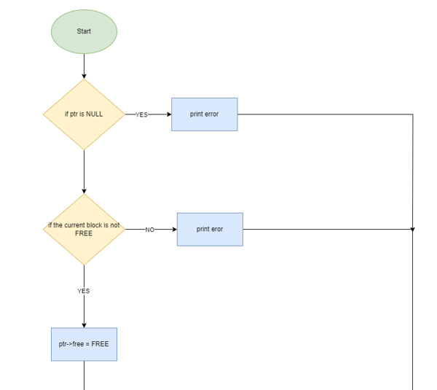
My_free function

Slide 8
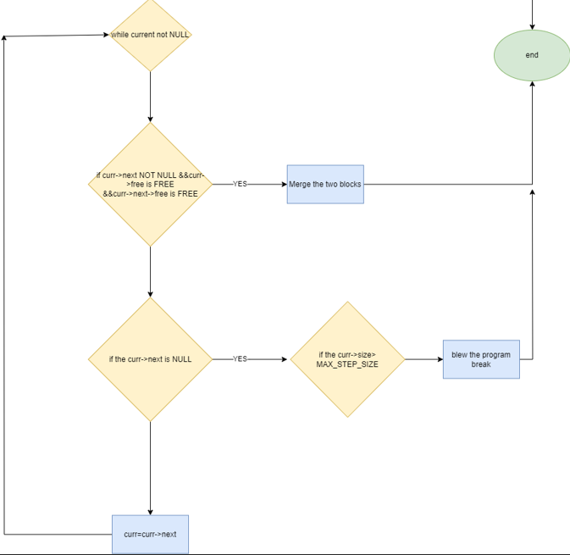
My_free function

Slide 9
Heap in Virtual memory.
unInitialize data
Stack
argv
Initialize data
text
unInitialize data
Increasing address

Slide 10
Heap in Virtual memory.
PB
unInitialize data
Stack
argv
Initialize data
text
unInitialize data
block1
block2
block3
block4
Increasing address

Slide 11
Heap in Virtual memory.
PB
unInitialize data
Stack
argv
Initialize data
text
unInitialize data
block1
block2
block3
block4
block5
block6
Increasing address

Slide 12
Heap in Virtual memory.
PB
unInitialize data
Stack
argv
Initialize data
text
unInitialize data
block1
block2
block3
block4
block5
Increasing address

Slide 13
Heap in Virtual memory.
PB
unInitialize data
Stack
argv
Initialize data
text
unInitialize data
block1
block2
block3
block4
Increasing address

Slide 14
Split function
100
100
address
next
prev
size
free
address
next
prev
size
free
address
next
prev
size
free

Slide 15
Split function
100
address
next
prev
size
free
address
next
prev
size
free

Slide 16
Split function
100
100
address
next
prev
size
free
address
next
prev
size
free
address
next
prev
size
free

Slide 17
Split function
200+ metadata size
address
next
prev
size
free
address
next
prev
size
free

Slide 18
Heap in Virtual memory.
unInitialize data
Stack
argv
Initialize data
text
unInitialize data
Increasing address

Slide 19
Heap in Virtual memory.
PB
unInitialize data
Stack
argv
Initialize data
text
unInitialize data
block1
block2
block3
block4
Increasing address

Slide 20
Heap in Virtual memory.
PB
unInitialize data
Stack
argv
Initialize data
text
unInitialize data
block1
block2
block3
block4
block5
block6
Increasing address

Slide 21
Heap in Virtual memory.
PB
unInitialize data
Stack
argv
Initialize data
text
unInitialize data
block1
block2
block3
block4
block5
Increasing address

Slide 22
Heap in Virtual memory.
PB
unInitialize data
Stack
argv
Initialize data
text
unInitialize data
block1
block2
block3
block4
Increasing address

Slide 23
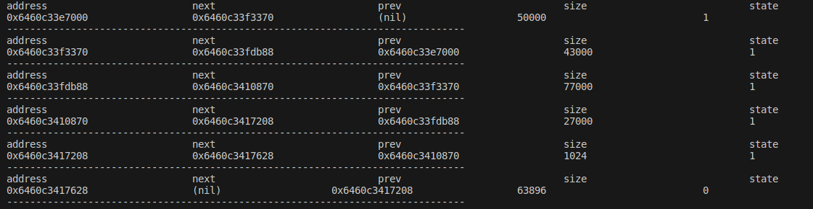
Test cases.

Slide 24
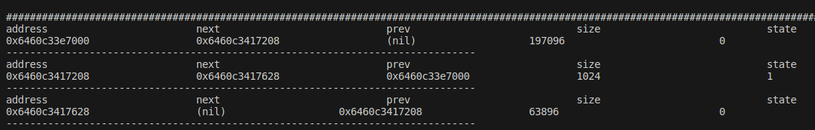
Test cases.

Slide 25
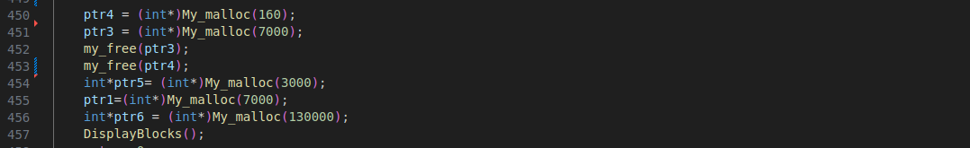
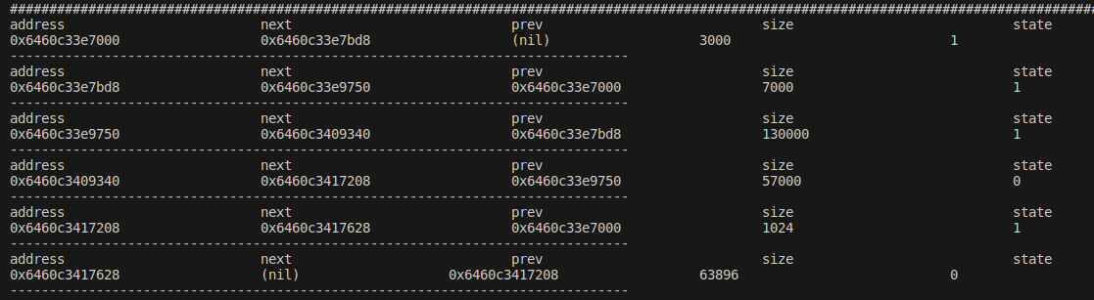
Test cases.

Slide 26
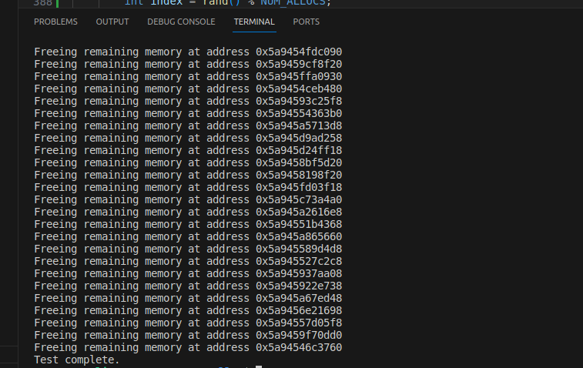
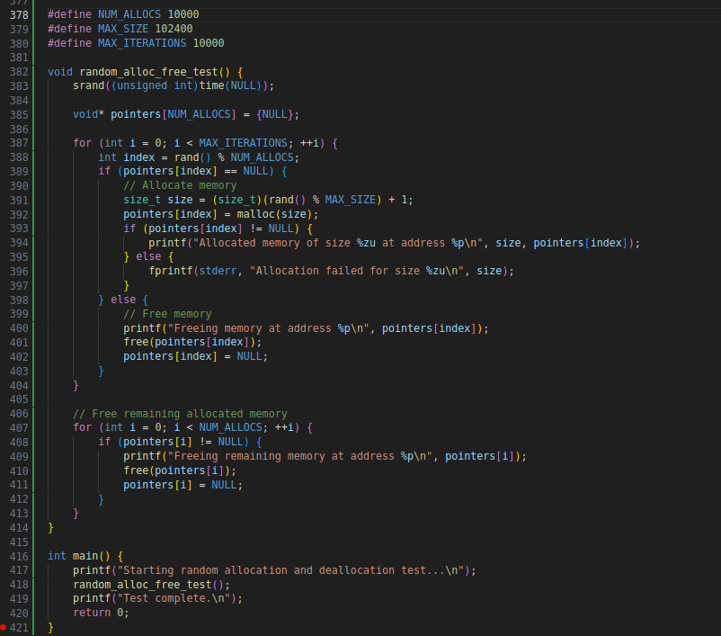
Test cases.(random allocating and freeing)

Slide 27
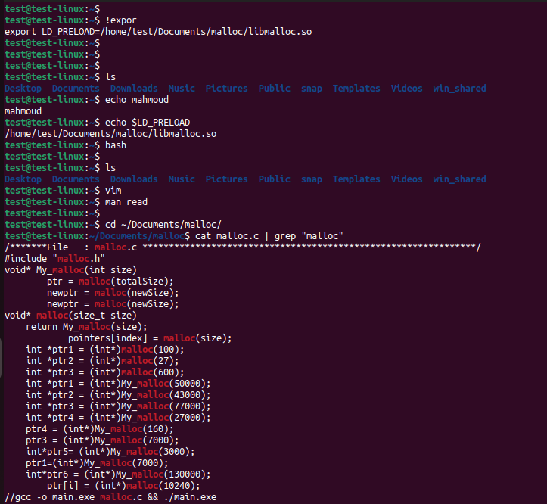
Moniem hmm VS glibc hmm

Slide 28

Bad News

